Slide 1
Fluid Mechanics MEP 290 2 ^{ND} semester 1434 H Course Instructor: Dr. Mohamed Fekry Course Associate: Eng. Asif Zu Zaman
1/18

Slide 2
Fluid Mechanics
Fluid Mechanics, MEP 290, 3 Cr. Hr. + 1 Cr. Hr. Lab
Text Book: Fluid Mechanics, Fundamentals and Applications By: Yunus A. Çengel and
John M. Cimbala, 2006
Fluid Mechanics By: Frank M. White, 5th Edition, McgrawHill
Fundamentals of Fluid Mechanics; By Munson Young Okiishi; 5th Edition
Classes: Sat. & Mon.: 10:00 – 10:50 AM
Lab. and Tot. : Wed.: 10:00 – 11:50 AM
Office hours: Sat. and Mon. 11am-12pm
Office hours: Sun. and Tue. 10am-12pm

Slide 3
Fluid Mechanics
Students in the first course in fluid mechanics might ask:
What is fluid mechanics ?
What I will be studying in it?
Why should I study it?

Slide 4
Fluid Mechanics Overview
Fluid Mechanics
Gas
Liquids
Statics
Dynamics
, Flows
Air, He, Ar, N₂, etc.
Water, Oils, Alcohols, etc.
Stability
Pressure
Buoyancy
Compressible/
Incompressible
Surface
Tension
Laminar/
Turbulent
Compressibility
Density
Viscosity
Steady/Unsteady
Vapor
Pressure
Viscous / Inviscid
Chapters 1&2: Introduction
Fluid Dynamics:
Rest of Course
Chapter 3: Fluid Statics

Slide 5
PHASES
- LIQUID
- GAS / VAPOR
- SOLID
Similarities Differences ?
Cohesive forces, Molecule spacing, Volume
FLUID?

Slide 6
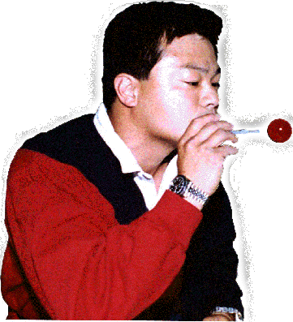
Fluids
Definition
Fluids are any materials that flow (deform) when force (shearing stress) is applied.
On Earth, fluids conform to the shape of a container. Examples of fluids: water, air, and carbon dioxide.
Fluids 2/18

Slide 7
Which of these are fluids?
Piece of wood
Drop of water
Particles of sand
A diamond
Steel beam
A feather
A chunk of coal
Oxygen
A mound of flour
Baking soda

Slide 8
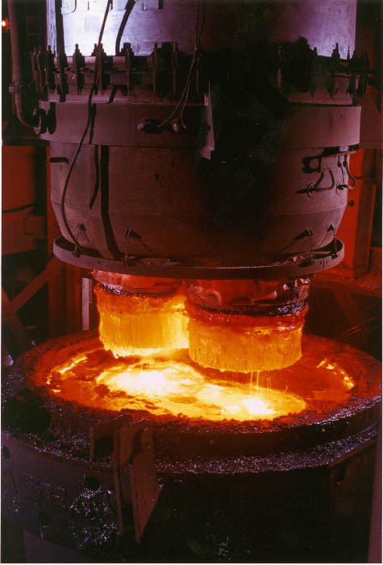
Is steel a fluid?
Notes:
Steel being made at Cleveland and Indiana Harbor Works steel plants.
Ultra-low carbon steel is easier to form and has better electrical characteristics.

Slide 9
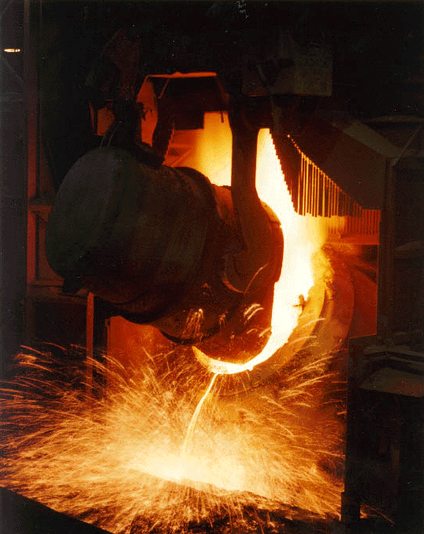
Steel melts and pours like a fluid in its molten state.

Slide 10
Fluid Mechanics
Fluid mechanics deals with the behavior of fluids at
rest ( Fluid statics )
and in motion ( Fluid dynamics )

Slide 11
Why Study Fluids?
Two of three states of matter are fluids.
Solids can behave like fluids under many conditions.
Earth’s atmosphere contains fluids.
Profitable industries are based on fluids.
Models and equations can predict the behavior of fluids.
The human body is 80% water.
Notes:
Two of three states of matter are fluids.
gases and liquids
Solids can behave like fluids under many conditions.
Sand pours and conforms to a container’s shape.
Earth’s atmosphere contains fluids.
oxygen, water vapor, ozone, etc.
Profitable industries are based on fluids.
water purification and dams
air circulation, heating and cooling
Models and equations can predict the behavior of fluids.
The human body is 80% water.

Slide 12
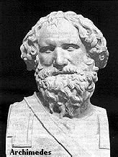
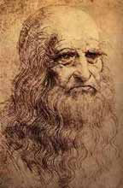
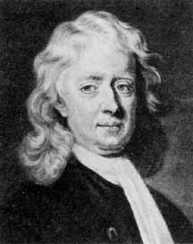
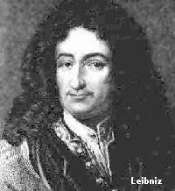
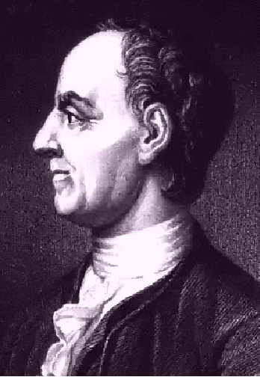
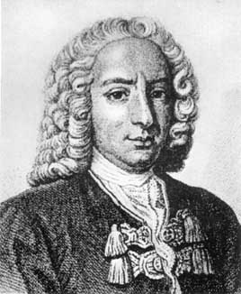
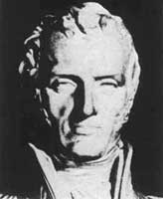
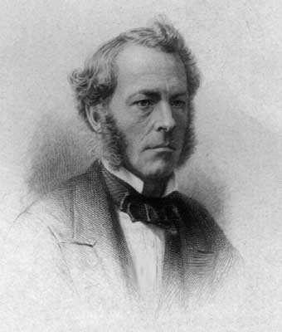
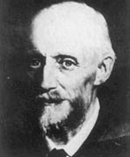
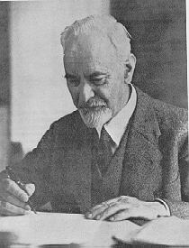
History
Faces of Fluid Mechanics
Archimedes
287 BC - 212 BC
Da Vinci
1452 - 1519
Newton
1642 - 1726
Leibniz
1646 - 1716
Euler
1707 - 1783
Bernoulli
1700–1782
Navier
1785 - 1836
Stokes
1819 - 1903
Reynolds
1842 - 1912
Prandtl
1875 - 1953

Slide 13
The Golden Age In Islam 700 - 1700

Slide 15
Fluids Research
Fluids researchers seeks insight into:
Fluid reaction to energy
Fluids containing particles and gas bubbles
Fluids interacting with solid boundaries
Fluids changing phases
Equations and models to predict motions
Fluids 8/18
Notes:
Fluids researchers seeks insight into:
Fluid reaction to energy (like heat and light).
Fluids containing particles and gas bubbles.
Fluids interacting with solid boundaries (like tank walls, contact lines, and sharp corners).
Fluids changing phases (gas to liquid to solid).
Equations and models to predict motions.

Slide 16
Course Title | English Code /No | ARABIC code/no. | contact hours /week |  |  | c.U.
 |  |  | Th. | Pr. | Tr. | TCU
Fluid Mechanics | MEP 290 |  | 3 | 1 | - | 3
Pre-requisites |  | PHYS 281 , MATH 202
Course Description: Concepts and definitions. Fluid statics. Forces on submerged surfaces and bodies. Non–viscous flow, Conservation of mass, momentum and energy equations. Bernoulli’s equation. Dimensional analysis, the Pi–theorem, and similarity. Pipe flow, Losses in conduit flow. Laminar and turbulent flow.

Slide 17
Objectives:
Identify the basic properties of fluids and the various types of fluid flow configurations encountered in practice.
Recognize the importance and application of dimensions, units and dimensional homogeneity in engineering calculations.
Compute the viscous forces in various engineering applications as fluids deform due to the no-slip condition.
Discuss the various effects of surface tension, e.g. pressure difference and capillary rise.
Determine the variation of pressure in a fluid at rest.
Calculate the forces exerted by a fluid at rest on plane or curved submerged surfaces.
Compute the effect of buoyancy on submerged bodies.
Identify the various types of flow and plot the velocity and acceleration vectors.
Apply the mass conservation equation in a flow system.
Utilize the Bernoulli equation to solve fluid flow problems and recognize its limitation.

Slide 18
Utilize the energy equation to determine turbine power output and pumping power requirements.
Incorporate the energy conversion efficiencies in the energy equation.
Determine the various kinds of forces and moments acting on a fluid flow field.
Apply the method of repeating variables to identify non–dimensional parameters.
Understand the concept of dynamic similarity and how to apply it to experimental modeling.
Calculate the major and minor losses associated with pipe flow system and determine the pumping power requirements.

Slide 19
Introduction to Fluid Mechanics and its Basic Concepts
Properties of Fluids
Pressure and Fluid Statics
Fluid Kinematics
Mass, Bernoulli and Energy Equations
Momentum Analysis of Flow Systems
Dimensional Analysis and Modeling
Flow in Pipes
Losses in Piping System
Piping Network and Pump Selection
Introduction to Computational Fluid Dynamics (CFD) and understanding to use CFD Software FLUENT for solving fluid flow problems.

Slide 20
Assessment methods for the above elements
1 st Midterm Exam: 20%
2 nd Midterm Exam : 20%
Quizes, Project Report/others : 20%
Final Exam: 40%
Total: 100%
Text book:
Fluid Mechanics, Fundamentals and Applications By: Yunus A. Çengel and John M. Cimbala, 1st Ed., 2006
Supplementary references
Fluid Mechanics By: Frank M. White, 5th Edition, McgrawHill
Fundamentals of Fluid Mechanics; By Munson Young Okiishi

Slide 21
Time table for distributing theoretical course content
Week | Theoretical Course Content | Remarks
1 | INTRODUCTION AND BASIC CONCEPTS Basics of Fluid Mechanics Classification of Fluid Flow System and Control Volume
2 | INTRODUCTION AND BASIC CONCEPTS Importance of Dimensions and Units Problem Solving Technique
3 | PROPERTIES OF FLUIDS Density and Specific Gravity Viscosity, dynamic and kinematic viscosity Surface tension and Capillary Effect
4 | PROPERTIES OF FLUIDS Vapour pressure and Cavitation Energy and Specific Heats Coefficient of Compressibility
5 | PRESSURE AND FLUID STATICS Pressure The manometer The manometer and atmospheric Pressure Introduction to Fluid Statics

Slide 22
6 | PRESSURE AND FLUID STATICS Hydrostatic Forces on Submerged Plane Surfaces Hydrostatic Forces on Submerged Curved Surfaces Buoyancy and Stability
7 | FLUID KINEMATICS Lagrangian & Eulerian Specifications Streamline, Pathline & Streak Line Linear Strain rate and Shear Strain Rate Vorticity & Circulation Stream Function
8 | MASS, BERNOULLI, AND ENERGY EQUATIONS Introduction Conservation of Mass The Bernoulli Equation Application of Bernoulli Equation

Slide 23
9 | MASS, BERNOULLI, AND ENERGY EQUATIONS General energy Equation Energy Analysis of Steady Flow Examples and Applications
10 | MOMENTUM ANALYSIS OF FLOW SYSTEMS Newton’s Law and Conservation of Momentum Choosing a Control Volume Forces Acting on a Control Volume The Linear Momentum Equation
11 | DIMENSIONAL ANALYSIS AND MODELING Dimension and Units Dimensional Homogeneity Dimensional Analysis and Similarity
12 | DIMENSIONAL ANALYSIS AND MODELING The method of repeating variables and the PI Theorem Experimental Testing and Incomplete Similarity
13 | FLOW IN PIPES Introduction Laminar and Turbulent Flow The Entrance Region Laminar Flow in Pipes
14 | FLOW IN PIPES Turbulent Flow in Pipes Minor Losses Piping Networks and Pump Selection Flow rate and Velocity Measurements
 | Final Exam

Slide 24
Hope we will all enjoy this course.
Feel free to meet me to discuss your individual problems.
KING ABDULAZIZ UNIVERSITY - RABIGH BRANCH
 | FACULTY OF ENGINEERING
 | Second Semester 2013/1434
Dr. Mohamed Fekry
Time | 9:00-10:00 |  |  |  |  |  | 10:00-11:00 |  |  |  |  |  | 11:00-12:00 |  |  |  |  |  | 12:00-13:00 |  |  |  |  |  | 13:00-14:00 |  |  |  |  |  | 14:00-15:00
x 10 minutes | 1 | 2 | 3 | 4 | 5 | 6 | 1 | 2 | 3 | 4 | 5 | 6 | 1 | 2 | 3 | 4 | 5 | 6 | 1 | 2 | 3 | 4 | 5 | 6 | 1 | 2 | 3 | 4 | 5 | 6 | 1 | 2 | 3 | 4 | 5 | 6
Saturday |  |  |  |  |  |  | FLUID MECHANICS MEP290 |  |  |  |  |  | OFFICE HOUR
Sunday |  |  |  |  |  |  | OFFICE HOURS
Monday |  |  |  |  |  |  | FLUID MECHANICS MEP290 |  |  |  |  |  | OFFICE HOUR
Tuesday |  |  |  |  |  |  | OFFICE HOURS
Wednesday |  |  |  |  |  |  | FLUID MECHANICS MEP290 |  |  |  |  |  | FLUID MECHANICS Lab.
x 10 minutes | 1 | 2 | 3 | 4 | 5 | 6 | 1 | 2 | 3 | 4 | 5 | 6 | 1 | 2 | 3 | 4 | 5 | 6 | 1 | 2 | 3 | 4 | 5 | 6 | 1 | 2 | 3 | 4 | 5 | 6 | 1 | 2 | 3 | 4 | 5 | 6
Time | 9:00-10:00 |  |  |  |  |  | 10:00-11:00 |  |  |  |  |  | 11:00-12:00 |  |  |  |  |  | 12:00-13:00 |  |  |  |  |  | 13:00-14:00 |  |  |  |  |  | 14:00-15:00

